Slide 1
Business Intelligence Concepts, Tools, and Applications
Week 5: BI Maturity, Strategy, and Summative Project
Lesson 1: BI Strategy

Slide 2
BI Strategy
Learning Objectives
Identify critical success factors for implementing a BI strategy

Slide 3
BI Transformation road map
According to Pant (2009) a transformation plan needs to include actionable steps to move from current state to a future state:
As is state
To be state
Technology-driven BI initiatives
Multiple BI systems
No enterprise-wide BI standards
Limited or no-data governance
Data in silos resulting in multiple unsynchronized reporting solutions
Each BI system has own set of governance and standards
Business collects data from multiple systems and spends a lot of time in data processing
Lack of collaborative BI environment
Business-driven BI
One version of truth
Collaborative BI environment
Effective data governance
BI initiatives align with the overall enterprise goals
BI adoption empowers all in the enterprise with better decision-making abilities
Standardized enterprise-wide BI/DW methodologies and tools
Data quality issues addressed in holistic manner
Adopted from Pant, P. “Business intelligence (BI) How to build successful BI strategy”, Deloitte Consulting LLP. 2009.
Notes:
Source: adopted from Pant, P. “Business intelligence (BI) How to build successful BI strategy”, Deloitte Consulting LLP. 2009.
According to Pant (2009) a transformation plan needs to include actionable steps to move from current state to a future state.

Slide 4
BI Strategy
According to Pant (2009), the following are important considerations for developing an effective BI strategy
Why do you need BI strategy?
It is a challenge to design a successful BI enterprise by selecting the right combination of people, processes, and technology.
Effective BI strategy ensures that enterprise objectives, business strategy, investments, and BI are aligned.
A broad set of processes, technologies, and stakeholders
for collecting, integrating, accessing, and analyzing information for the purpose of helping enterprise make better business decisions.
for documenting the needs as identified by the stakeholders, highlighting how BI fits into the broader enterprise vision.
BI strategy should take into consideration appropriate framework, methodology, processes, governance, systems, and technology to deliver value that aligns with the business objectives and priorities.
From Pant, P. “Business intelligence (BI) How to build successful BI strategy”, Deloitte Consulting LLP. 2009.
Notes:
Source: Adapted from Pant, P. “Business intelligence (BI) How to build successful BI strategy”, Deloitte Consulting LLP. 2009.

Slide 5
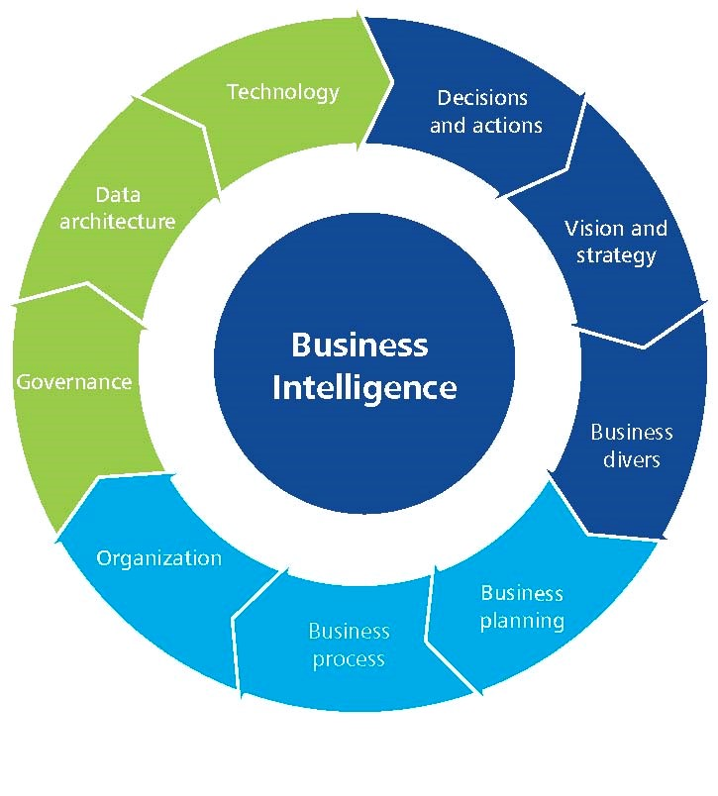
BI Strategy
Source: Adopted Pant, P. “Business intelligence (BI) How to build successful BI strategy”, Deloitte Consulting LLP. 2009.
Notes:
Source: Adopted Pant, P. “Business intelligence (BI) How to build successful BI strategy”, Deloitte Consulting LLP. 2009.

Slide 6
BI Framework
BI framework brings together data governance, data architecture, technical architecture, data integration, data quality, end-user information delivery, data security etc. to empower the BI initiatives.
Framework should set standards that BI participants must adhere to.
Framework should provide means to connect significant components that are part of your overall BI vision.
Establishing BI competency center or center of excellence as part of the BI framework will help you in integrating BI best practices with the on-going BI work and the BI environment of the enterprise.
From Pant, P. “Business intelligence (BI) How to build successful BI strategy”, Deloitte Consulting LLP. 2009.
Notes:
Source adapted From Pant, P. “Business intelligence (BI) How to build successful BI strategy”, Deloitte Consulting LLP. 2009.

Slide 7
BI Implementation approach
A point solution
a single or a few related applications
Enterprise-wide BI
providing organizational BI infrastructure
BI to support organizational transformation
enabling a new business model
From Pant, P. “Business intelligence (BI) How to build successful BI strategy”, Deloitte Consulting LLP. 2009.
Notes:
Source: Adapted From Pant, P. “Business intelligence (BI) How to build successful BI strategy”, Deloitte Consulting LLP. 2009.

Slide 8
Implementation Targets
According to Pant (2009), BI implementation approach should have several targets.
First Implementation target:
The development of a single or few related BI applications.
This target is similar to the initial DSS that organizations created.
It is often a point solution for a departmental need, such as campaign management in marketing. Sponsorship, approval, funding, impacts, and benefits are typically at the departmental level.
A data mart is usually created to provide necessary data.
Organizations must be careful that the mart (an “independent” data mart) does not become a “data silo” that stores data that is inconsistent and cannot be integrated with other data.
From Pant, P. “Business intelligence (BI) How to build successful BI strategy”, Deloitte Consulting LLP. 2009.
Notes:
Source: Adapted from Pant, P. “Business intelligence (BI) How to build successful BI strategy”, Deloitte Consulting LLP. 2009.

Slide 9
Implementation Targets Continued
Second Implementation Target
The creation of infrastructure that supports current and future BI needs.
A critical component is an enterprise data warehouse. Because it is an enterprise-wide initiative, senior management often provides sponsorship, approval, and funding.
The impacts and benefits are felt throughout the organization.
From Pant, P. “Business intelligence (BI) How to build successful BI strategy”, Deloitte Consulting LLP. 2009.
Notes:
Source: Adapted From Pant, P. “Business intelligence (BI) How to build successful BI strategy”, Deloitte Consulting LLP. 2009.

Slide 10
Implementation Targets Continued
Final Implementation Target
Organizational transformation where BI is used to fundamentally change how a company competes in the marketplace.
BI supports a new business model and enables the business strategy. Because of its scope and importance, sponsorship, approval, and funding originate at the highest organizational levels.
The impact on personnel and processes can be significant. The benefits are organization-wide.
From Pant, P. “Business intelligence (BI) How to build successful BI strategy”, Deloitte Consulting LLP. 2009.
Notes:
Source: Adapted From Pant, P. “Business intelligence (BI) How to build successful BI strategy”, Deloitte Consulting LLP. 2009.

Slide 11
BI Strategy Critical Success factors
According to Pant (2009), the following are critical in developing a successful a BI strategy:
Create a business case and outline the expected benefits
Have an enterprise-wide perspective and obtain buy in from stakeholders, especially the senior executives
Establish criteria for success
Set up change management procedures and Adopt best practices and standards
Treat information as an asset and align BI strategy with the overall IT strategy and enterprise goals
From Pant, P. “Business intelligence (BI) How to build successful BI strategy”, Deloitte Consulting LLP. 2009.
Notes:
Source Pant (2009) (Business intelligence (BI) How to build successful BI strategy”, Deloitte Consulting LLP. 2009”)

Slide 12
BI Strategy Critical Success factors- Continued
Do a current state, future state, and gap analysis
Think actionable and baby steps, and Use iterative implementation approach with parallel tracks
Establish governance body and Assess BI readiness of the organization and identify related gaps and issues
Work with frameworks, adopt proven methodologies, and consider all BI components
Document and analyze the constraints and assumptions
From Pant, P. “Business intelligence (BI) How to build successful BI strategy”, Deloitte Consulting LLP. 2009.
Notes:
Source Adapted From Pant, P. “Business intelligence (BI) How to build successful BI strategy”, Deloitte Consulting LLP. 2009.

